Slide 1

Bangladesh Army University of Science & Technology (BAUST), Saidpur
Department : Computer Science & Engineering
Course Code : CSE2200
Course Title : Software Development Project II
Submitted By :
Submitted To :
Student Name : Zarrin Tasnim
ID : 180201102
Batch : 8th
Level : 2 Term : II
Section :B
Date of Submission :28.11.2020
Teacher Name : MD. Toukir Ahmed
Designation : Lecturer

Slide 2
Project Name
Page no 01
Online Food Ordering System
Guided By :
Presented By:
MD. Toukir Tuhin
Zarrin Tasnim

Slide 3
Online food ordering system
Page no 02
ABSTRACT
The Online Food Ordering System described in this document has been designed to fill a specific niche in the market by providing small restaurants with the ability to offer their customers an online ordering option without having to invest large amounts of time and money in having custom software designed specifically for them. The system which is highly customizable, allow the restaurant employees to easily manage the site content , most importantly the menu, themselves through a very intuitive graphical interface.

Slide 4
Online food ordering system
Page no 03
INTRODUCTION
An online food menu is set up by the proposed food ordering system as per their customer can easily place the order. Also customer can easily track the orders with the food menu. The management improve food delivery service and preserves customers database. Motivation to develop this system is from the restaurants management system. To get the service efficiently the users of the system provides various facilities. Restaurants as well as Mass Facilities is consider by our system for our customers. Mostly mass users are person who are shifted to new cities and this can be considered as motivation to our system.

Slide 5
Online food ordering system
Page no 04
EXISTING SYSTEM
In the present scenario people have to physically visit the hotels or restaurant for eating food and have to make payment through cash mode most of the times due to unawareness advance technologies at certain places.
In this method time as well as physical work is required. Among which time is something that no one has in ample amount. The traditional food ordering procedure is not efficient enough for hotels and restaurant ,as they have to deal with crowd ,in their restaurant.

Slide 6
Online food ordering system
Page no 05
SCOPE & PURPOSE
To manage the online food ordering. It's helps to customer to book products from anywhere .Also make payment on delivery. It helps to people to book desire products at their prefer time.
The project has a wide scope, as it is not intendent to a particular organization. This project is going to develop generic software, which can be applied by any business organization. Moreover it provides facilities to its customer. Also the software is going to provide a huge amount of summary data.

Slide 7
Online food ordering system
Page no 06
PROPOSED SYSTEM
The proposed system ensure the complete freedom for users ,where user at his/her own system can logon to the website and book their desire products. Our proposed system allows only registered users to book the product ,view booking and cancel their booking as per their need.
In this proposal the entire work is done on online. Customer can send their queries and suggestions through a feedback from.

Slide 8
Online food ordering system
Page no 07
SOFTWARE USED
Notepad ++.
Browser (chrome).
XAMPP.
Mysql.
Operating system Windows 7 or above.

Slide 9
Online food ordering system
Page no 08
SYSTEM MODEL
START
Register
Login
Order Food
Name
Item Price
Quantity
Yes
All Order
Yes
Submit
Ticket

Slide 10
Online food ordering system
Page no 09
All Ticket
Edit Details
END

Slide 11

Online food ordering system
Page no 10
USE CASE DIAGRAM
View order list
View menu list
View customer list
Restaurant
View ticket
system

Slide 12
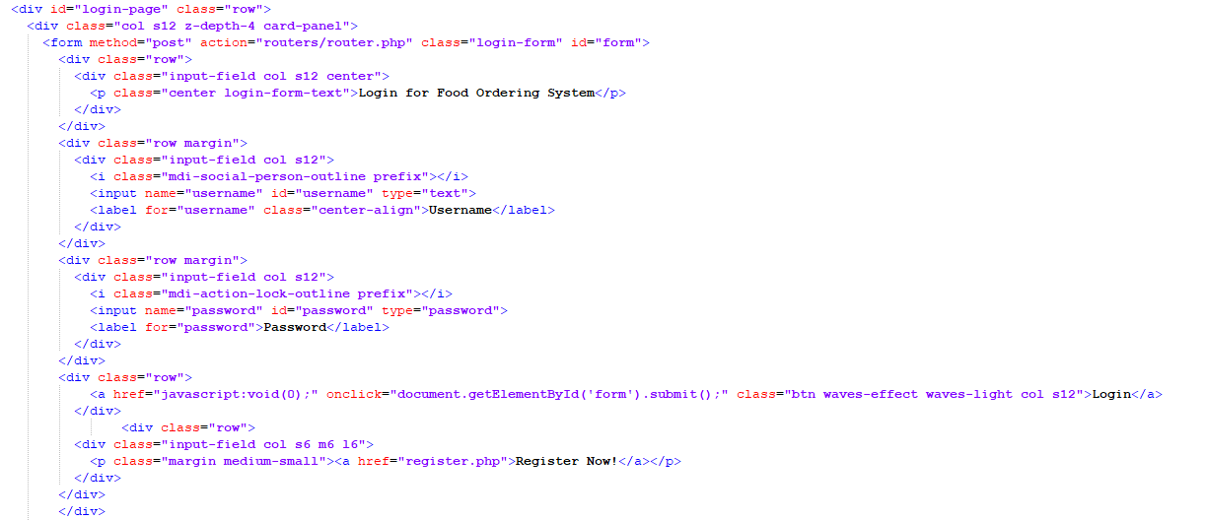
Online Food Ordering System
Page no 11
SCREENSHOT- SOME IMPORTANT CODE

Slide 13
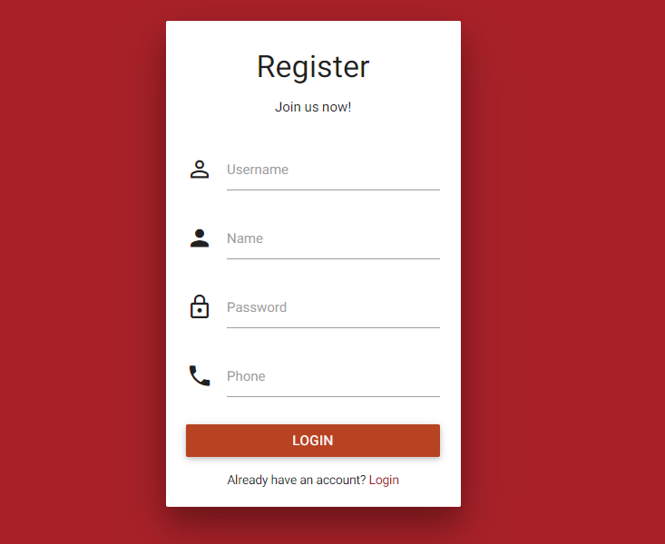
Online food ordering system
Page no 12
SCREENSHOTS-REGISTRATION PAGE

Slide 14
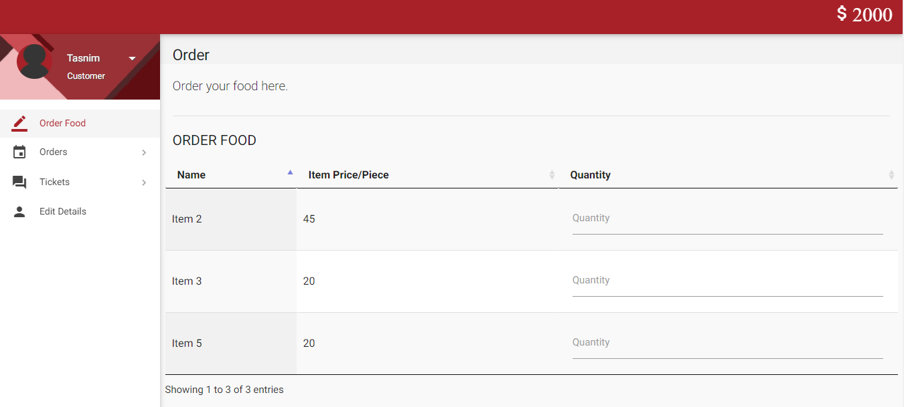
Online food ordering system
Page no 13
SCREENSHOT – HOME PAGE

Slide 15
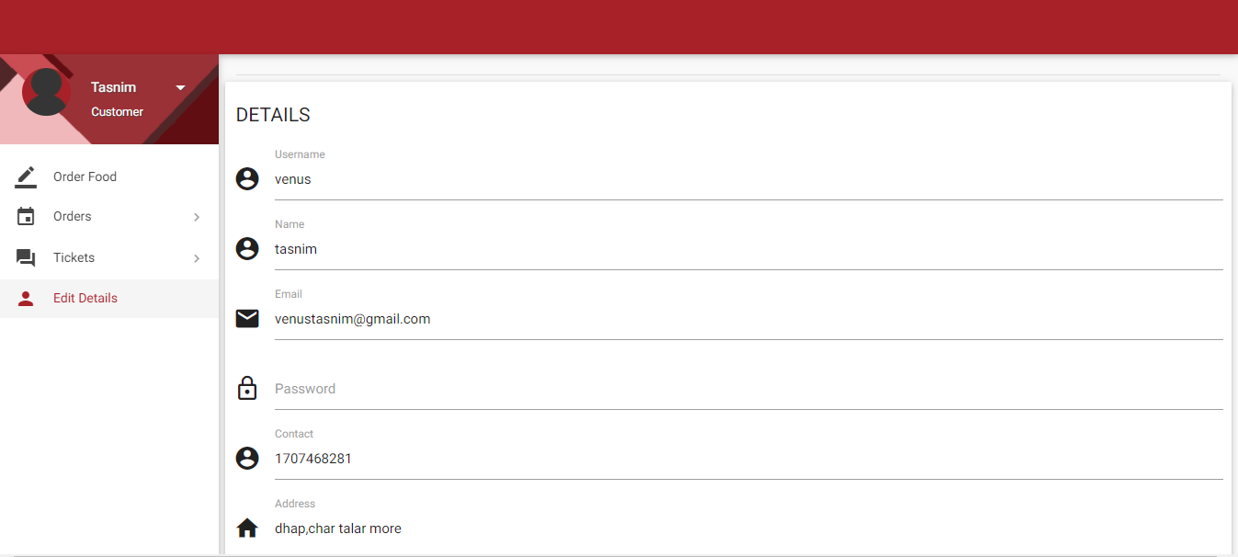
Online food ordering system
Page no 14
SCREENSHOT – USER DETAILS

Slide 16
Online food ordering system
Page no 15
FUTURE SCOPE
The web application involves almost all the features of online shopping. The future implementation will be online help for the customers and chatting with website administrator.

